Slide 1
Introduction to Different Type of Regression

Slide 2
1.
What and Why
What is regression and why cover it?

Slide 3
What is Regression?
Regression
Classification
Clustering
Anomaly Detection
Adaptive Learning
Def: Regression is a technique for investigating relationship between independent and continuous dependent variables.

Slide 4
Why Regression?
Regression is more than just linear relationships!

Slide 5
1.
Linear Regerssion

Slide 6

Linear Regression
Independent Variable
Simple Linear Regression
$$y=MX_{1}+C$$
Dependent Variable
Coefficient

Slide 7
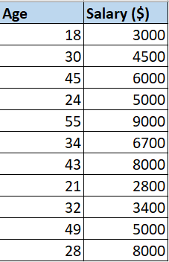


Linear Regression
$$y=MX_{1}+C$$
$$Salary=M∗Age+C$$

Slide 8
Linear Regression
$$y=MX_{1}+C$$
$$Salary=M∗Age+C$$

Slide 9


Linear Regression
ERRORS (residuals)
$${SUM\left(Errors\right)}^{2}→min$$

Slide 10
Linear Regression

Slide 11
Linear Regression
Pros
Performs well for data with linear relatioship.
Easy to implement and interpret.
Cons
Prone to outliers.
Prone to multicollinearoty.
Does not perform well for ranges it does not have data on.

Slide 12
2.
Logistic Regerssion

Slide 13
Logisitc Regression
Logistic regression predicts a value between 0 and 1
Eg:
Linear regression predicts how much a student scores.
Logistic regression predicts if a student gets accepted.

Slide 14
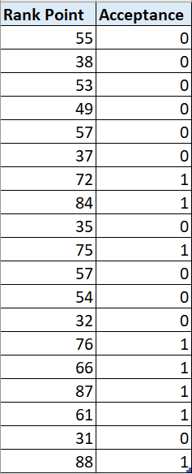
Logisitc Regression
Predict if a student will be accepted into NTU just by looking at their rank points.

Slide 15
Logisitc Regression

Slide 16
Logisitc Regression

Slide 17
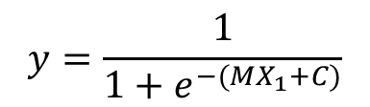

$$y=\frac{1}{1+e^{−(MX_{1}+C)}}$$
$$y=MX_{1}+C$$

Slide 18
Logistic Regression
Pros
Easy to implement and interpret.
Effiecent to train.
Cons
Prone to multicollinearoty.
Tough to form complex relationships.

Slide 19
3.
Decision Tree Regression

Slide 20



Decision Tree Regression
Root Nodes
$$X_{1}<20$$
Yes
No
Decision Tree
$$X_{2}<170$$
$$X_{2}≥170$$
Leaf Nodes

Slide 21
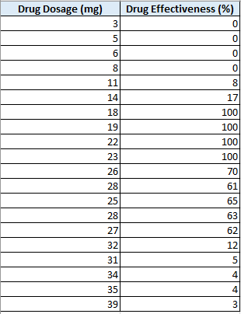
Decision Tree Regression
Predict the effectiveness from the dosage injected.

Slide 22
Decision Tree Regression

Slide 23
Decision Tree Regression
Dosage < 15
3.6% Effective
Dosage > 30
5.6% Effective
Dosage =< 25
100% Effective
64.2% Effective

Slide 24
Decision Tree Regression
Why not just eyeball?
Will be difficult once there are more than a single variable!
Age
Gender
Weight

Slide 25
Decision Tree Regression
Why not just eyeball?
Weight < 60
1.6% Effective
Dosage >= 30
Will be difficult once there are more than a single variable!
Age
Gender
Weight
5.6% Effective
Sex = Male
100% Effective
64.2% Effective

Slide 26
Decision Tree Regression
Pros
Easy to implement and interpret.
Works on both linear and non-linear datasets
Cons
Poor performance on small datasets.
Prone to overfitting

Slide 27
4.
Random Forest Regression

Slide 28
Random Forest Regression
Forest made up of many trees → Random Forest is just many Decision Trees
STEP 1: Pick K random data points
STEP 2: Build a Decision Tree using the K data, with random variables.
STEP 3: Repeat STEP 1 and 2 for N number of times (i.e. N number of trees)
STEP 4: New data point, make each of the N trees predict the value. Assign the new data point to the AVERAGE of all predicted values.

Slide 29
STEP 1: Pick K random data points
Original Dataset
Bootstrapped Dataset
Height | Age | Weight | Effectiveness
173 | 23 | 64 | 78%
162 | 15 | 59 | 65%
183 | 29 | 72 | 53%
171 | 34 | 60 | 82%
159 | 43 | 59 | 67%
Height | Age | Weight | Effectiveness
173 | 23 | 64 | 78%
173 | 23 | 64 | 78%
183 | 29 | 72 | 53%
171 | 34 | 60 | 82%
183 | 29 | 72 | 53%

Slide 30
STEP 2: Build a Decision Tree using the K data, with random variables.
Bootstrapped Dataset
Height
Height | Age | Weight | Effectiveness
173 | 23 | 64 | 78%
173 | 23 | 64 | 78%
183 | 29 | 72 | 53%
171 | 34 | 60 | 82%
183 | 29 | 72 | 53%

Slide 31
STEP 3: Repeat STEP 1 and 2 for N number of times (i.e. N number of trees)
Tree 1
Tree 2
Tree 3

Slide 32

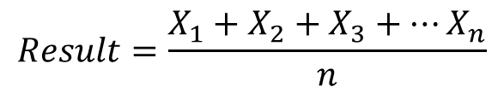


STEP 4: New data point, make each of the N trees predict the value. Assign the new data point to the AVERAGE of all predicted values.
Tree 1
Tree 2
$$x_{1}$$
$$x_{2}$$
Tree 3
$$Result=\frac{X_{1}+X_{2}+X_{3}+…X_{n}}{n}$$
$$x_{3}$$

Slide 33
Random Forest Regression
Pros
Usually more accurate than decision tree
Works on both linear and non-linear datasets
Cons
No interpretability
Prone to overfitting

Slide 34
Thanks!
Any questions?

